Slide 1
EV CAR RIDE-SHARING SYSTEM IN
UPM SERDANG CAMPUS
Name : Choo Hong Yee (179435)
Supervisor : Puan Siti Mariam Binti Shafie@Musa

Slide 2
Outline
Introduction
Problem Statement
Aim and objectives
Literature Review
Methodology
Project Planning
Result
References
25/10/2017
Secured In Campus Ride Sharing

Slide 3
Introduction
Advancement of internet has provide better connectivity among mankind.
Information sharing on internet is getting common, which leads to various forms of info-sharing including ride-sharing.

Slide 4
Problem Statement
Time taken travelling in campus with fully utilization of Electric Vehicle MyCOMS.
Overcrowded or over capacity issue with the limited mode of transportation to be minimized to ensure comfortability of users.
Efficiency of ride-sharing system design in a safe and secured environment to be emphasized.

Slide 5
Aim and Objectives
Aim:
The aim of this project is to develop a secured in campus ride-sharing application.
Objectives:
To design and create an EV ride-sharing application for students in UPM Serdang campus.
To predict station level demand of EV.
To evaluate the system design performance.

Slide 6
Ride Sharing
Car-pooling or car-sharing to reduce overall traffic condition [1]
Network can be sourced and improved using crowdsourcing. [2]
Bike Sharing
Last mile problem [3]
Network of bicycle spread across targeted stations. [4]
Rebalance and loading bicycle to stations according demand with the use of fuzzy logic. [5]
Android
Breakdown on architecture and components [6]
Main programming languages: Java and Kotlin [7]

Slide 7
Project development Flowchart
Hardware and Software Requirement
System Block Diagram
Software Development
System Architecture

Slide 8
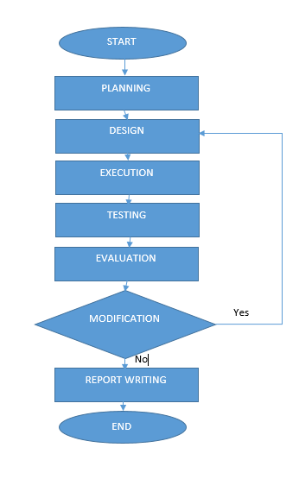
Project development Flowchart
Figure 1: The flowchart of the proposed Project.

Slide 9
Hardware and software requirement
Hardware:
- Computer (i7-4510U, 8GB RAM)
- Android Smart Phone (Android Marshmallow)
Software:
- Android Studio 3 (SDK version 27, Gradle build 3)
- Adobe Experience Design (User Interface Design)
- Jetbrain Pycharm Community Edition (python 3.6)
- SciKit Fuzzy Logic Library
Testing Area:
- UPM Serdang Campus

Slide 10
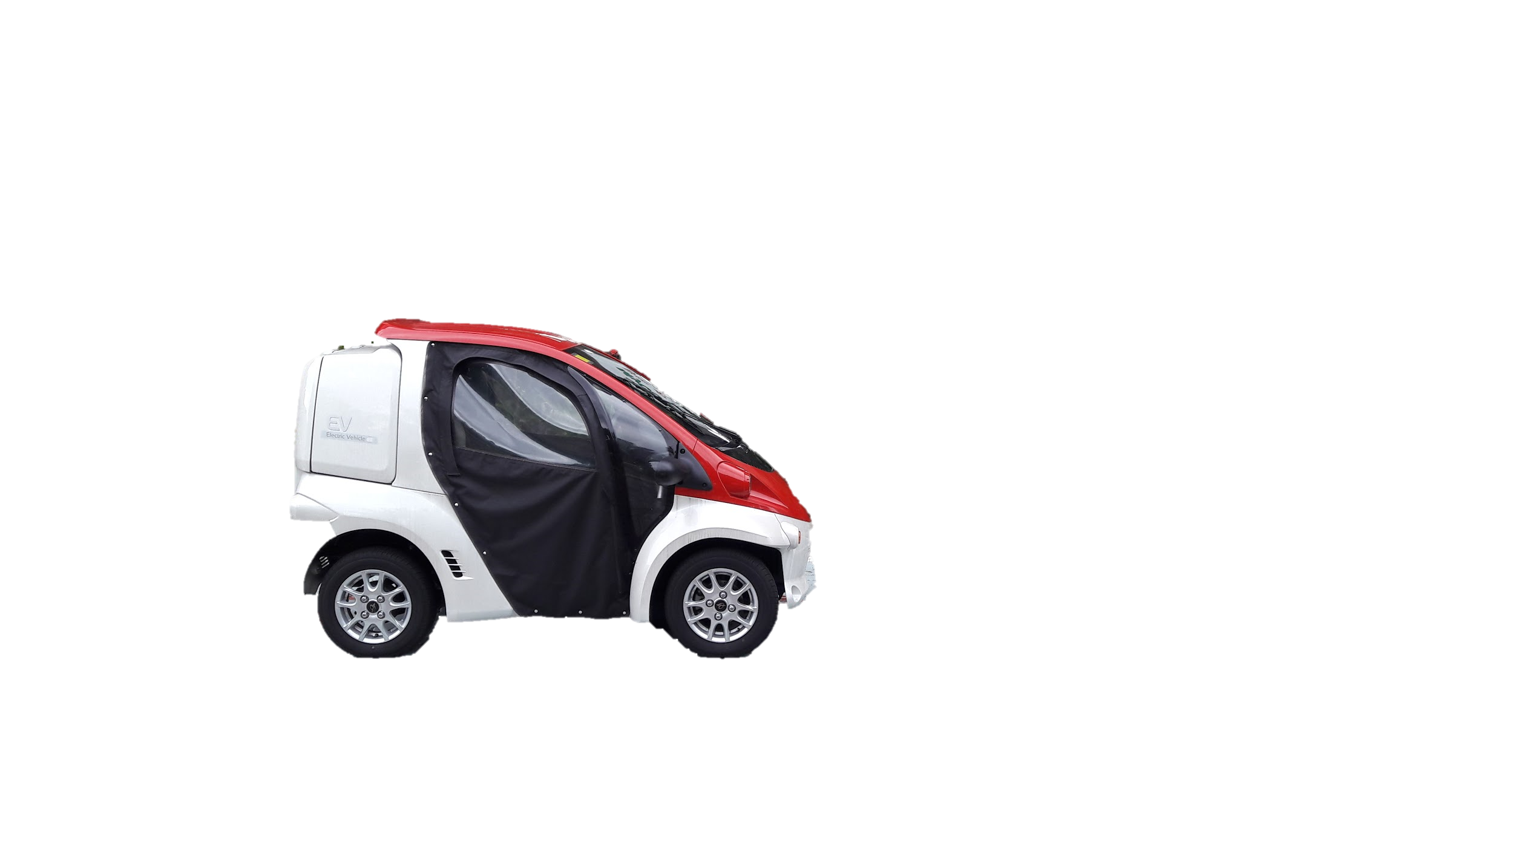
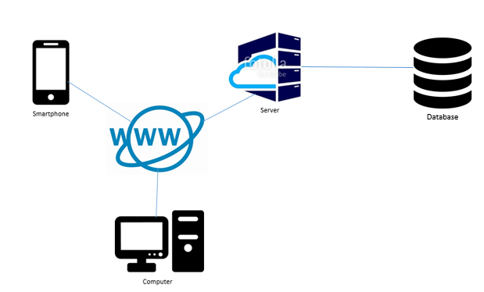
System Block Diagram
MyCOMS
Work to be done by others
------------------------------------------------------------------------------------------------------------------------------------------
My field of work
Figure 2: The system block diagram of the project.

Slide 11
Software Development
Application User Interface
Adobe Experience Design is used to design the interface.
Mobile Application
Android application is coded using Java.
Android Virtual Devices
Database
Firebase
API
Google Maps Direction API

Slide 12
Application Requirements
Report vehicle status
View vehicle status
Register a new vehicle
Monitor vehicles
View,modify and disable user account
View booking list

Slide 13
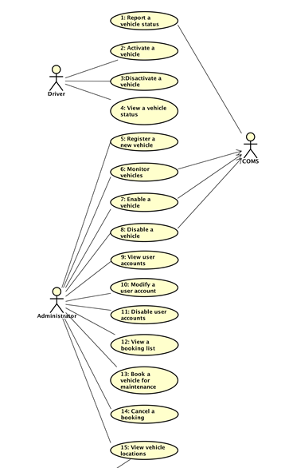
Use Case Diagram

Slide 14
Use Case Diagram (cont)

Slide 15
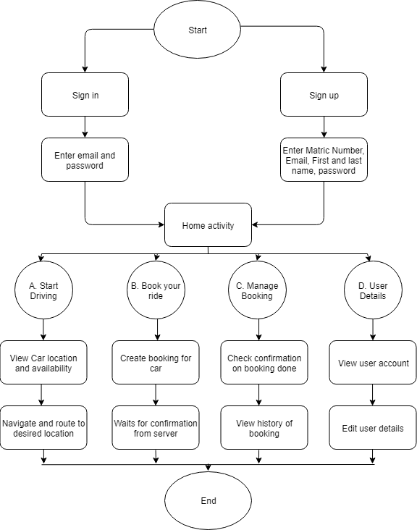
Flowchart of system

Slide 16
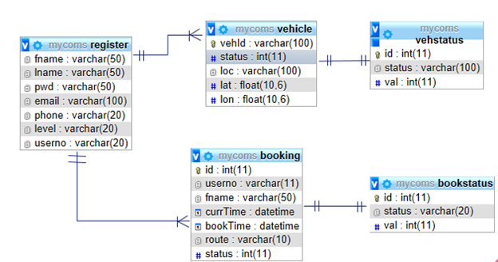
ER Diagram
Figure 2: Entity relationship diagram of database.

Slide 17
PROJECT PLANNING

Slide 18
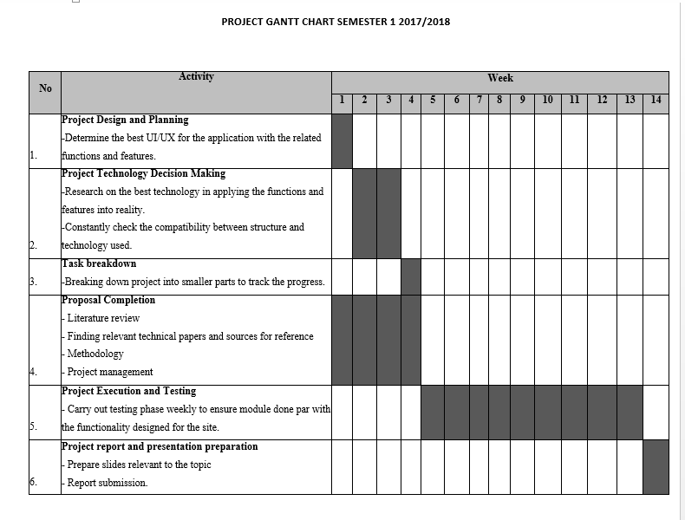
Gantt Chart

Slide 19
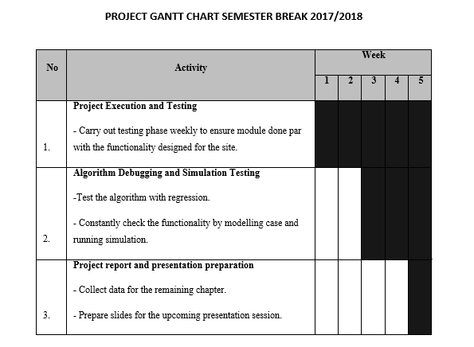
Gantt Chart (cont)

Slide 20
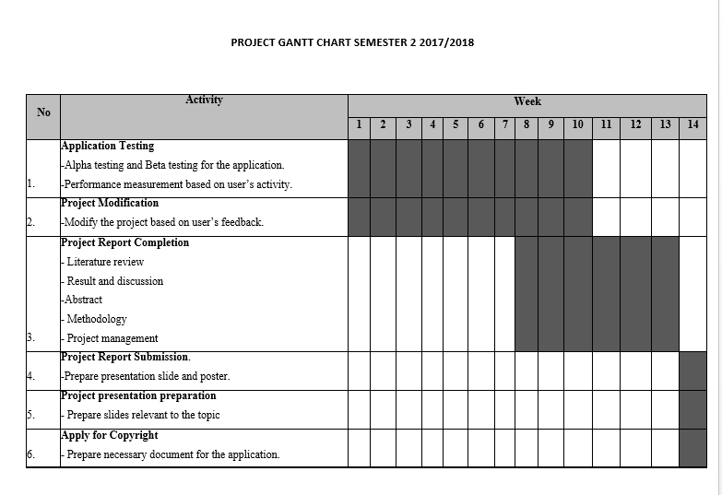
Gantt Chart (cont)

Slide 21
Task Breakdown
Login activity
Google Maps direction routing
Connecting to database
Station level demand prediction

Slide 22
RESULT

Slide 23
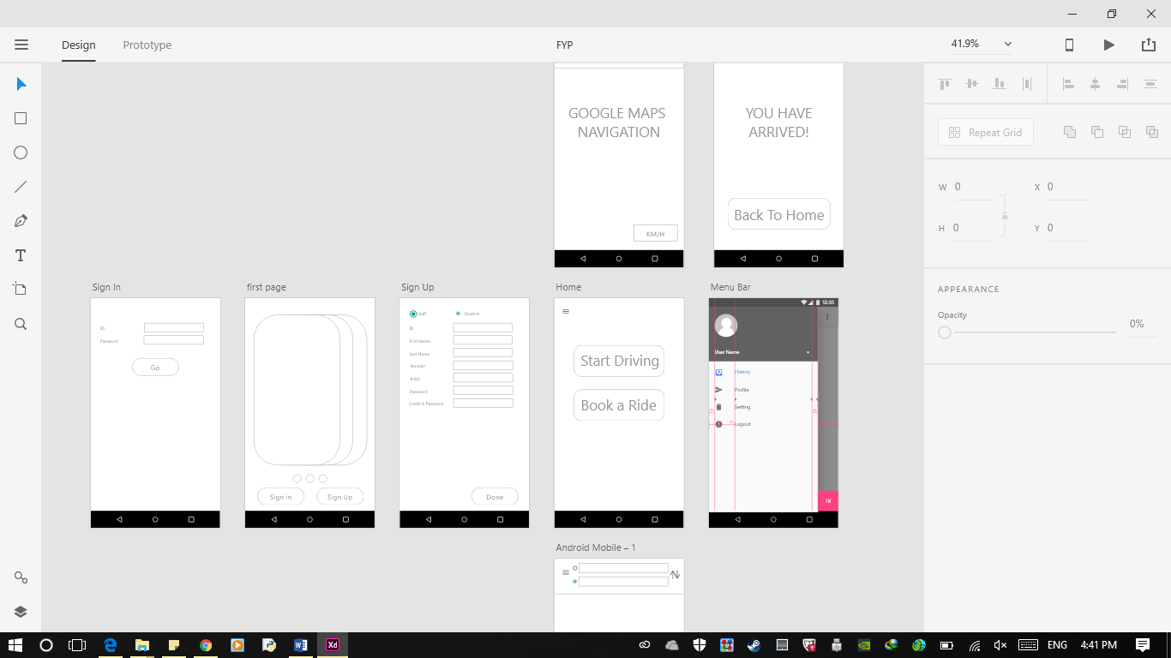
UI Design

Slide 24
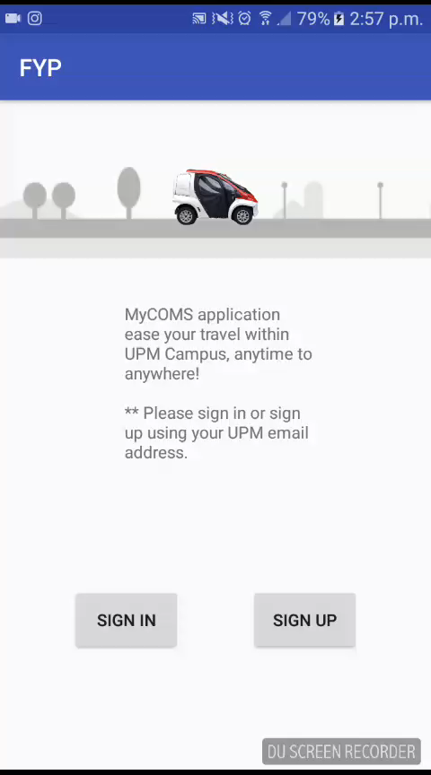
Main Activity

Slide 25
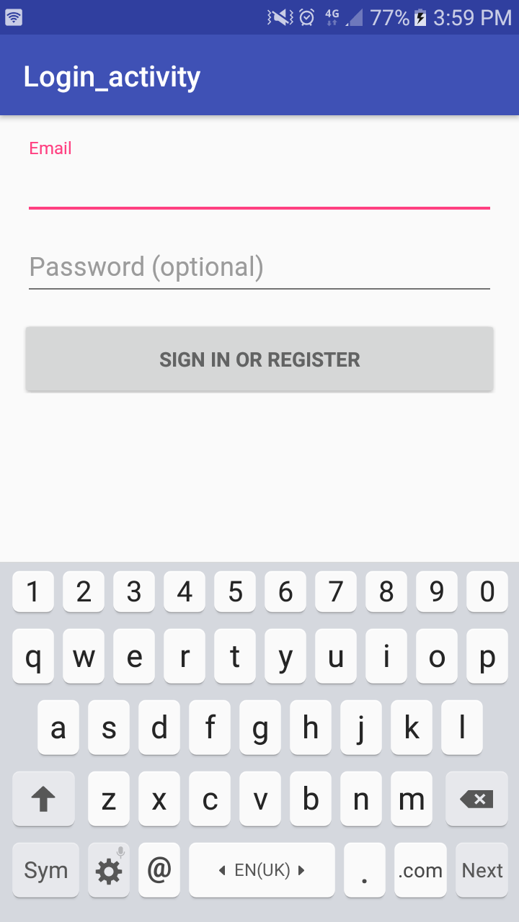
Login Activity

Slide 26
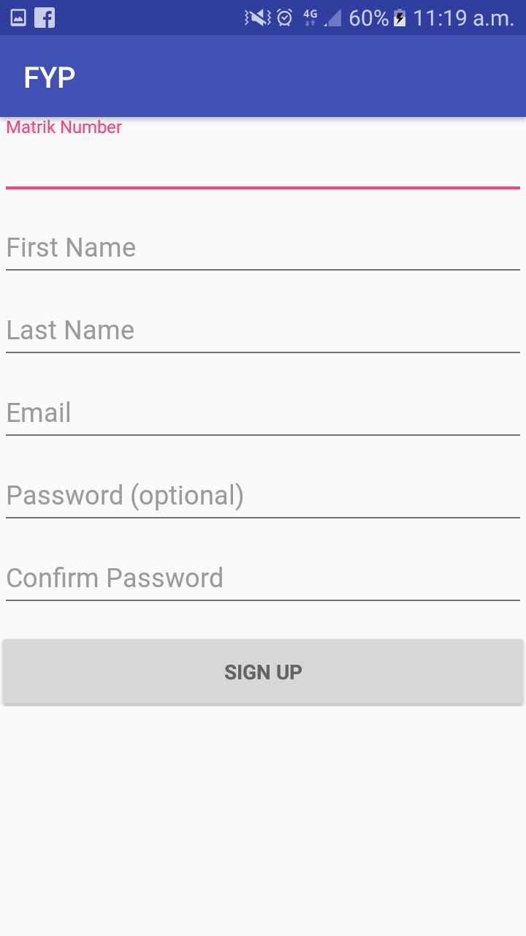
SignUp Activity

Slide 27
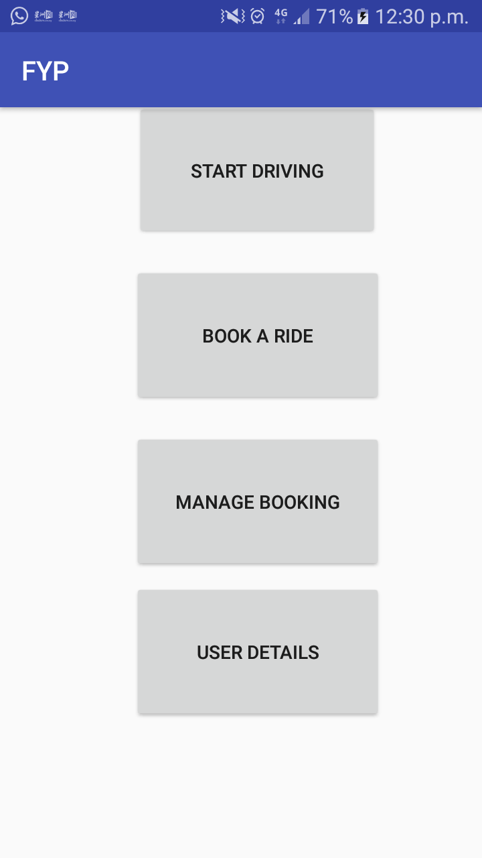
Home Activity

Slide 28
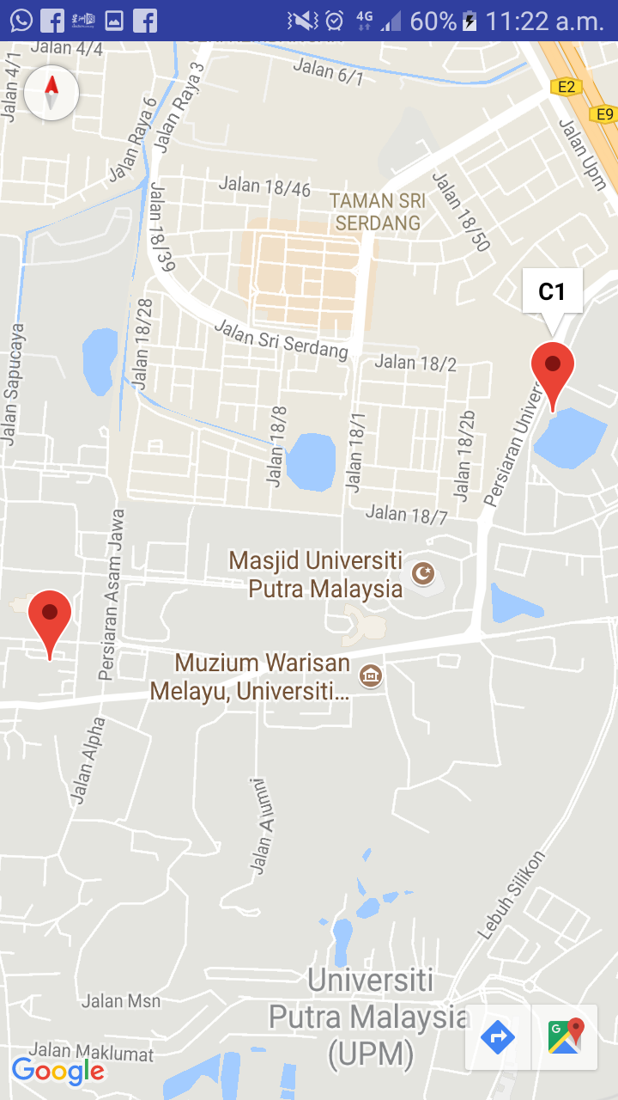
Maps Activity

Slide 29
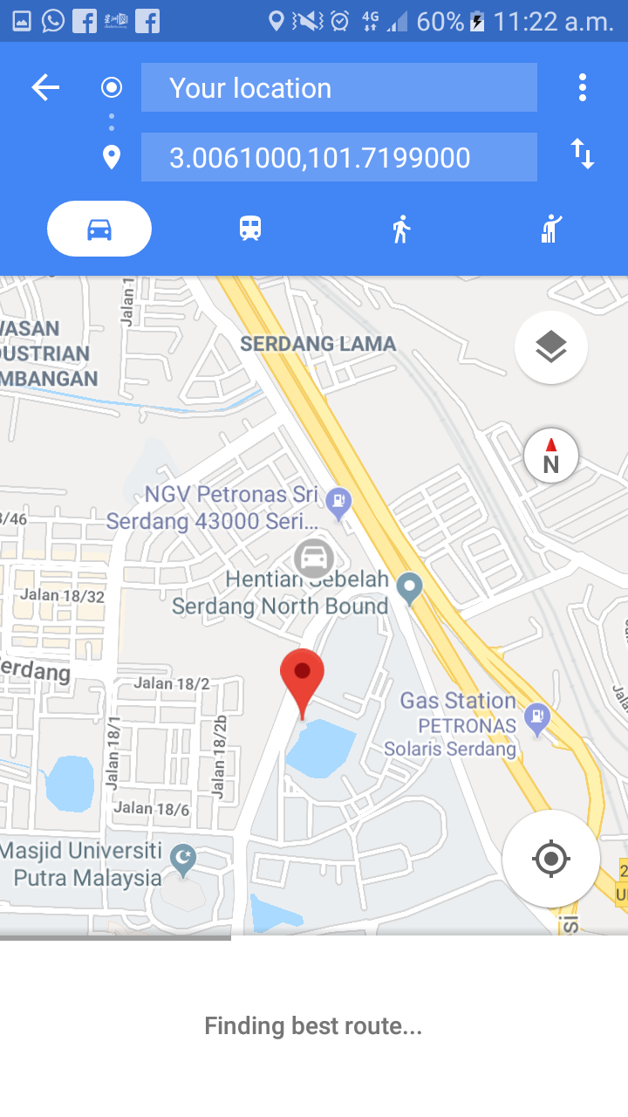
Maps Activity (cont)

Slide 30
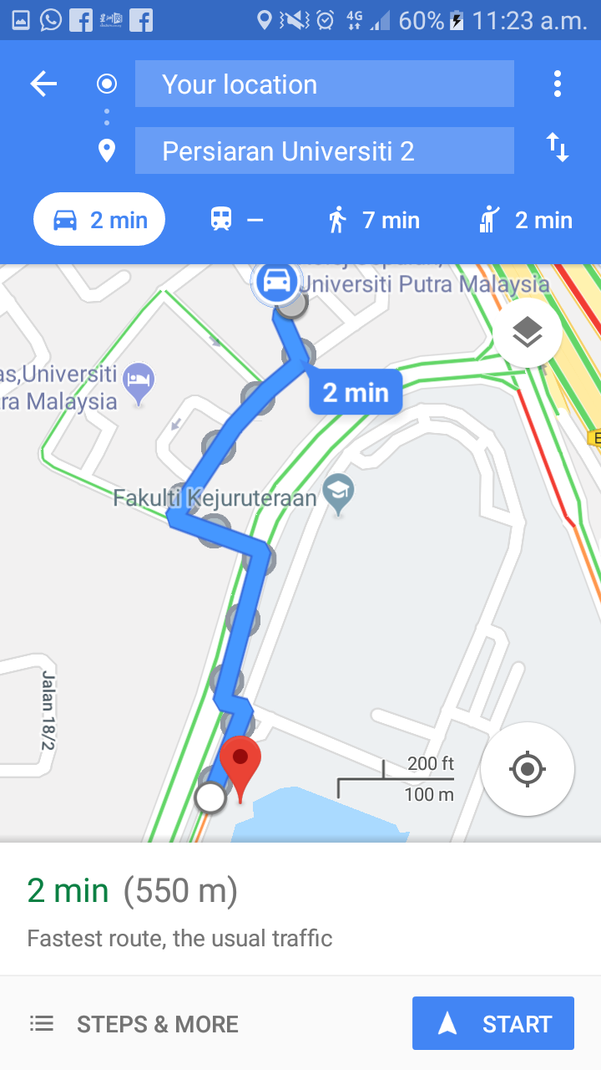
Maps Activity (cont)

Slide 31
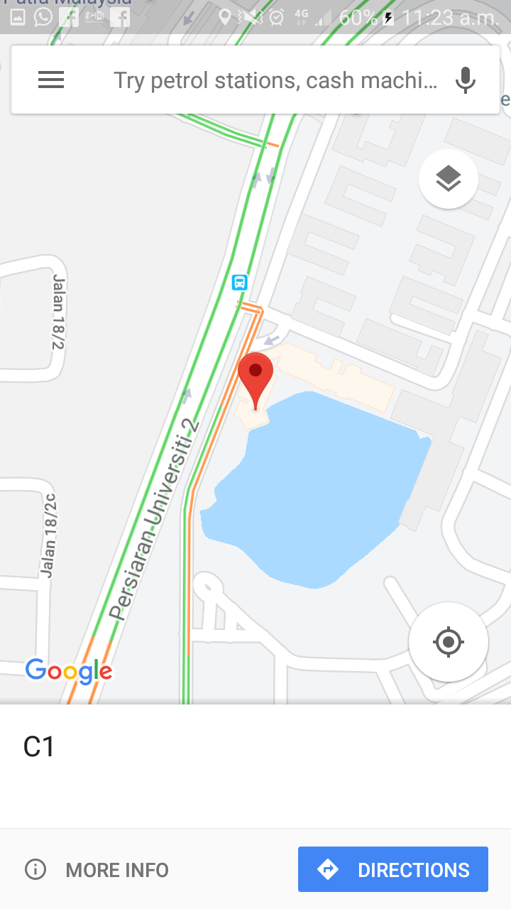
Maps Activity (cont)

Slide 32
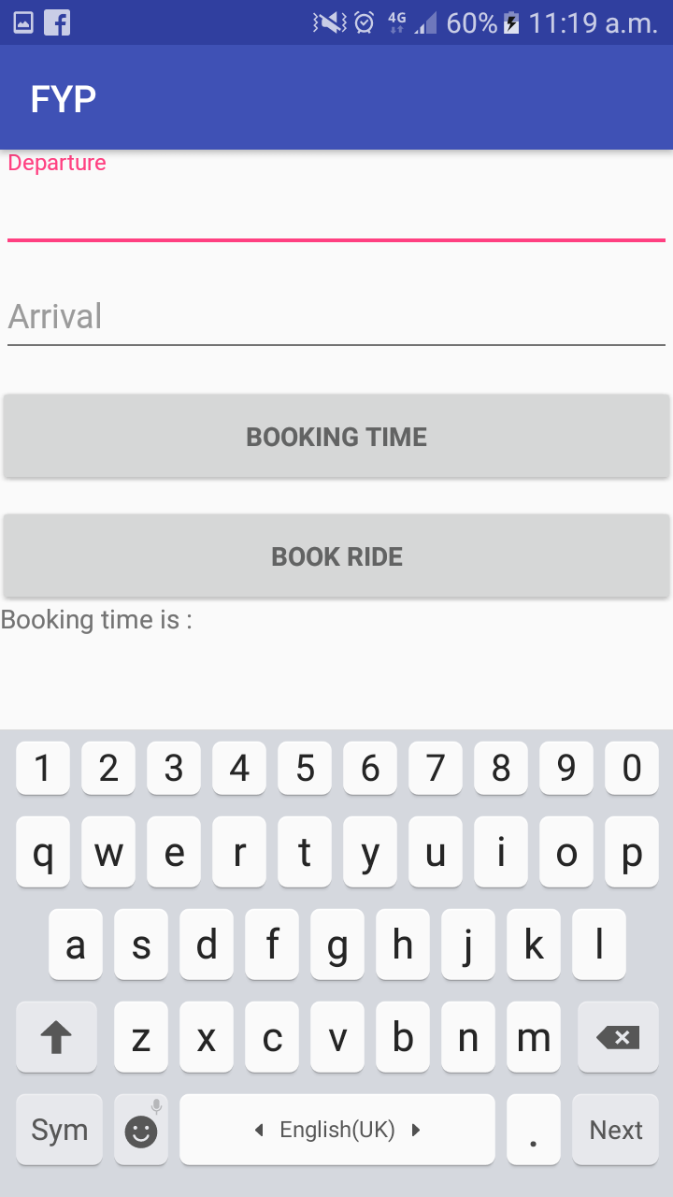
Book A Ride Activity

Slide 33
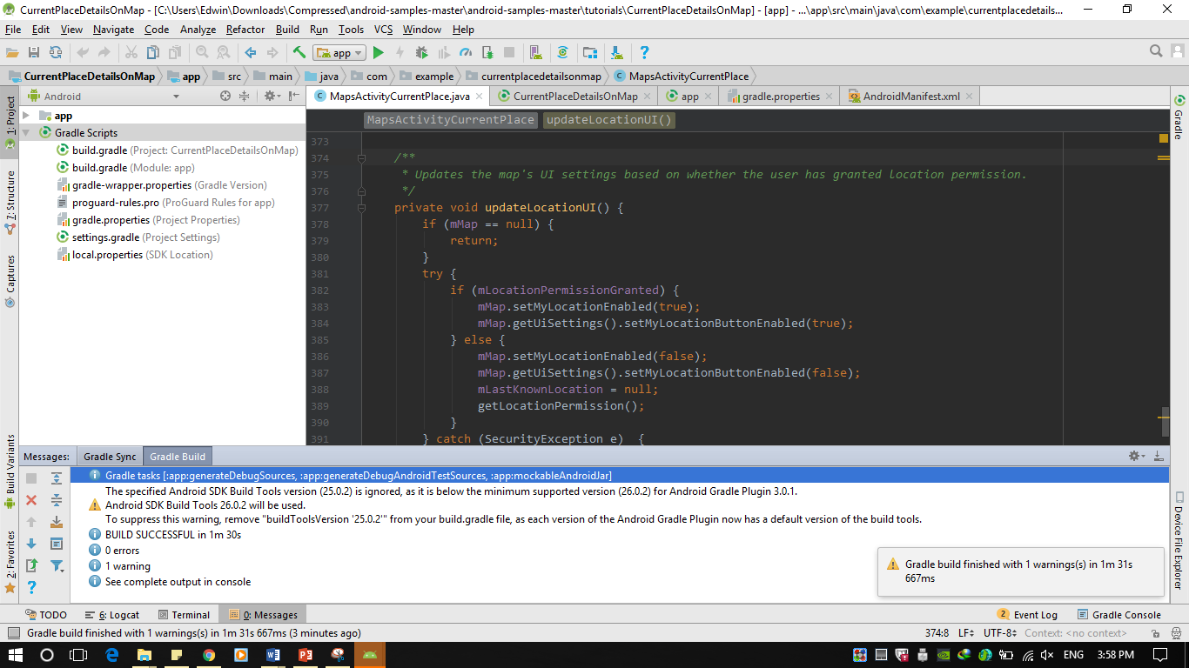
Google Maps API V2

Slide 34
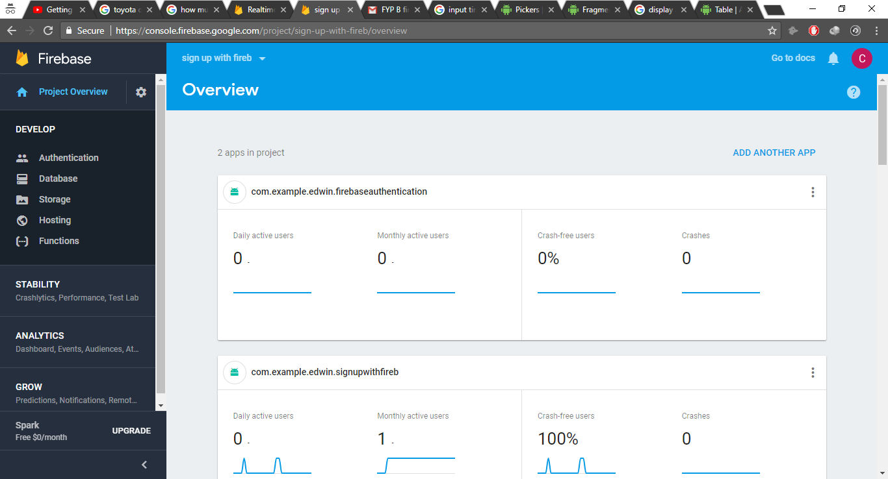
Firebase console

Slide 35
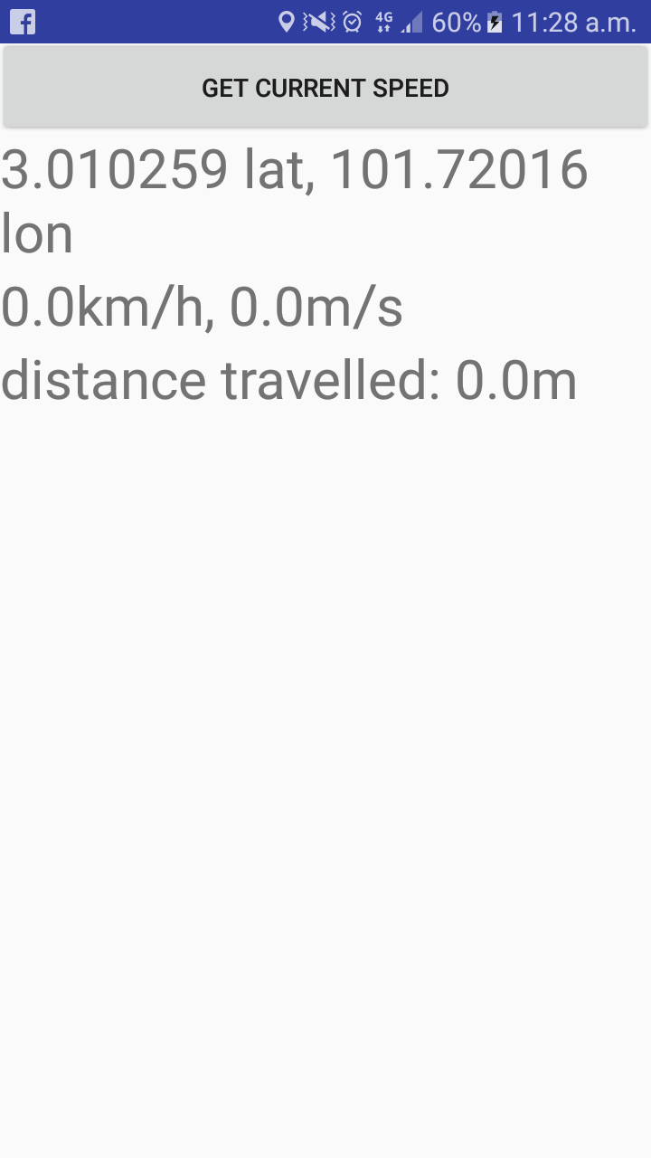
Get Location and Speed details

Slide 36
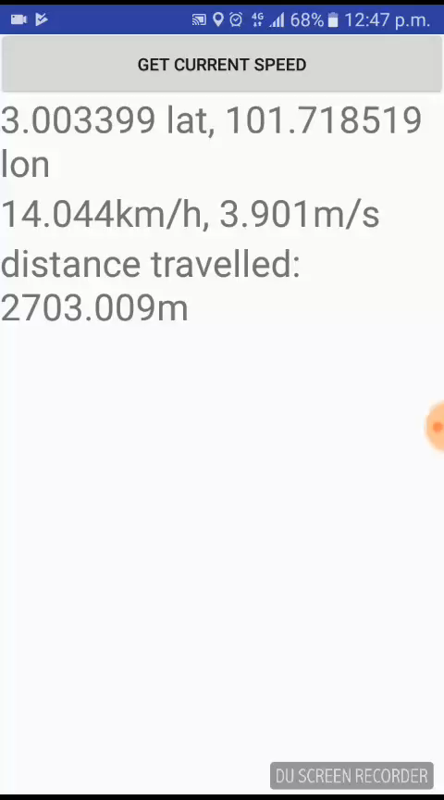
Get Location and Speed details

Slide 37
Prediction of Station Level Demand using Fuzzy Logic
Algorithm and case model is defined and coded using Python.
Algorithm design parameter:
Number of population
Weather
Location of station
Time of travel between station

Slide 38




Fuzzy Logic Input
Population
Location
Time of Travel
Temperature of the day

Slide 39
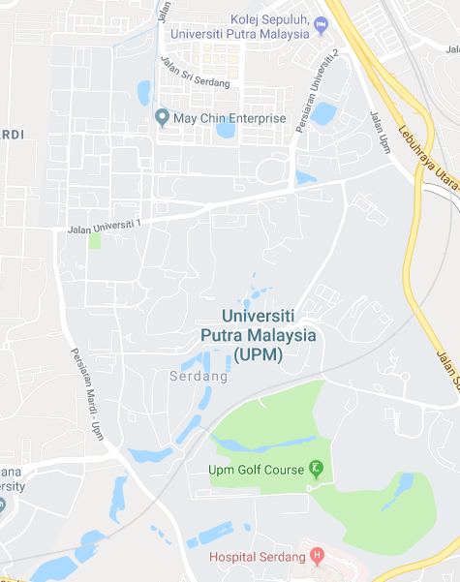

15 Station Location
39
39

Slide 40
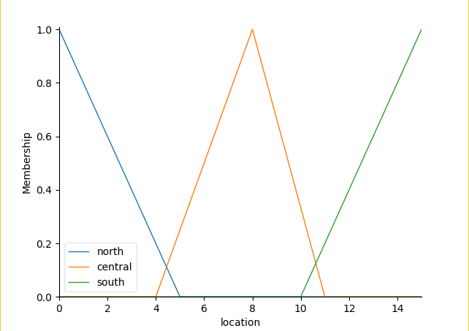
Station Location (cont)

Slide 41
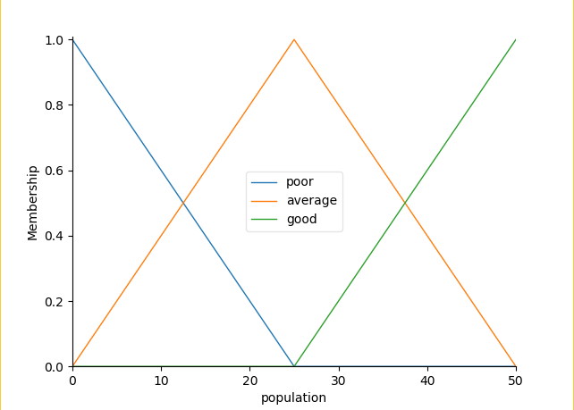
Population Membership Function

Slide 42
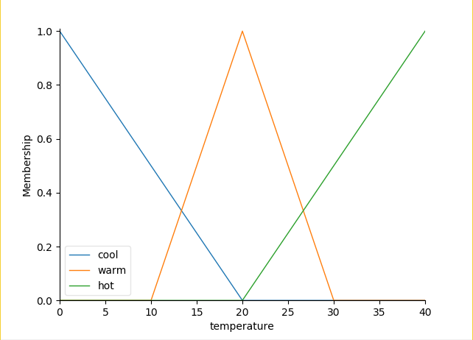
Population Membership Function

Slide 43
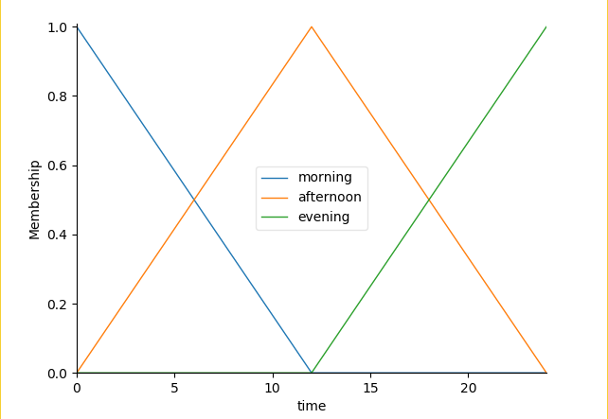
Time Membership Function

Slide 44
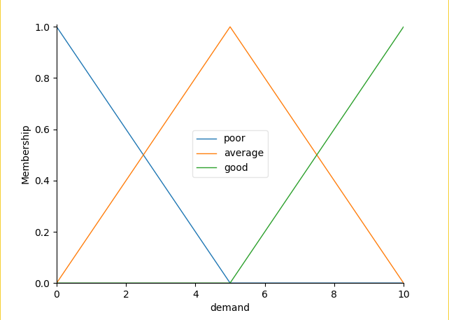
Fuzzy Logic Output
Station level demand (membership function)

Slide 45
Fuzzy Rules
IF location is North OR population is Good OR temperature is Cool OR time is in Morning,
then demand will be Good
IF location is South OR population is Average OR temperature is Warm OR time is in Afternoon,
then demand will be Good
IF location is Central OR population is Average OR temperature is Warm OR time is in Afternoon,
then demand will be Average
IF population is Poor OR temperature is Hot OR time is in Evening,
then demand will be Poor

Slide 46
RESULT

Slide 47
Range of inputs
location = 15 stations
population = 50 sample size
temperature = 40℃ as maximum of range
time = 24 hours

Slide 48
Inputs to the System (example)
location = 6.5 (central region)
population = 9.8
temperature = 20℃
time = 9am

Slide 49
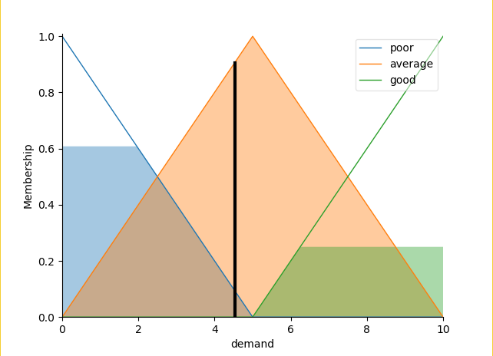
Defuzzified Result
Figure 6: Demand level of 4.52712851867

Slide 50
References
[1] F.R. Amirul, The Taxi Service Review Malaysia Context, Mediterranean Journal of Social Sciences, Vol 7 No 4,pp 559 - 563, 2016.
[2] D. Ulloa et al.,Mining Social Media for Open Innovation in Transportation Systems, 2016 Institute of Electrical and Electronics Engineers 19th International Conference on Intelligent Transportation Systems, pp 169- 174, 2016.
[3] S. Shaheen, S. Guzman, and H. Zhang, Bikesharing in Europe, the Americas, and Asia: past, present, and future, Transportation Research Record: Journal of the Transportation Research Board, pp. 159-167, 2010.
[4] M. Ricci, Bike Sharing- A Review Of Evidence On Impacts And Processes Of Implementation And Operation, Research in Transportation Business and Management 15, p28-38, 2015.

Slide 51
References (cont)
[5] S.M. Salaken et al. Forecasting Bike Sharing Demand Using Fuzzy Inference Mechanism. Springer International Publishing Switzerland 2015, the 22nd International Conference on Neural Information Processing, Part III, Lecture Note in Computer Science 9491, pp. 567–574, 2015.
[6] Colin Walls, Get Started with Android, https://www.ecnmag.com/article/2011/07/get-started-android , last accessed: 27/12/2017.
[7] Mike Cleron, Android Announces Support for Kotlin, https://android-developers.googleblog.com/2017/05/android-announces-support-for-kotlin.html , last accesed: 27/12/2017.

Slide 52
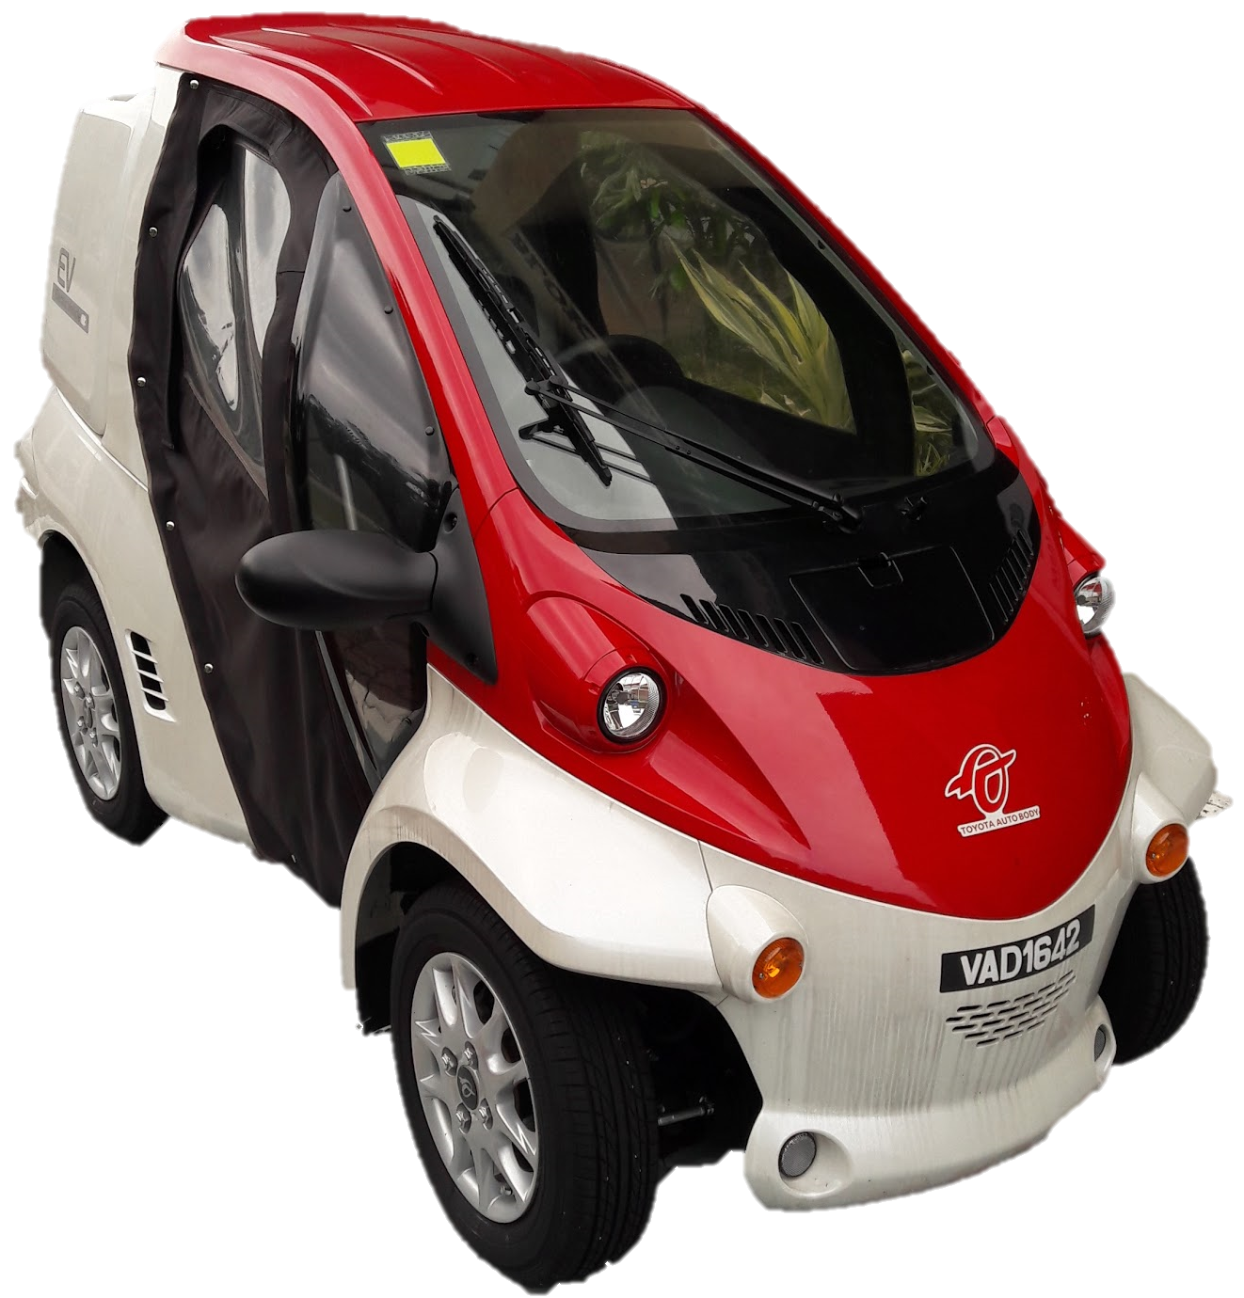
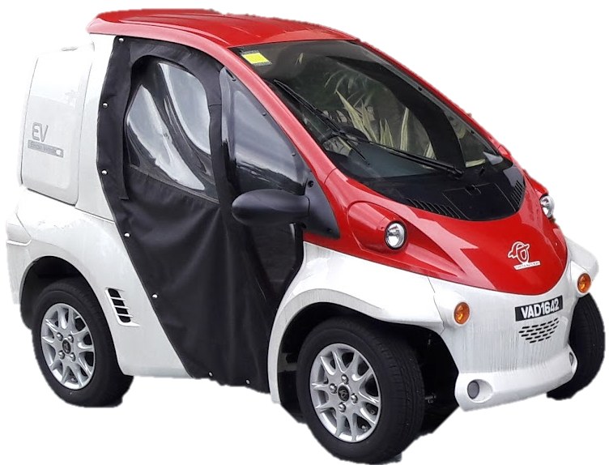
END OF SLIDE
THANK YOU

